Slide 1
EggBeater

Slide 2
Executive Summary: Purpose
To create an encryption system that provides superior file security
Eggbeater is a tool for generating encryption keys from fingerprints

Slide 3
Executive Summary:
Design and Methodology
MVC Architecture
Alterations
Agile Development
Modified Test-Driven Development
Unit Testing
Acceptance Testing
Object-Oriented Programming
Embedded Modifications

Slide 4
Executive Summary: Conclusion
What we finished
What we hoped to do
How are design helps us accomplish what we hoped to do

Slide 5
Research
GUI frameworks
Qt
Wxwidgets
Fingerprint modules
GT511C1R
Encryption libraries
Crypto++
OpenSLL, OpenAes, CyaSLL

Slide 6
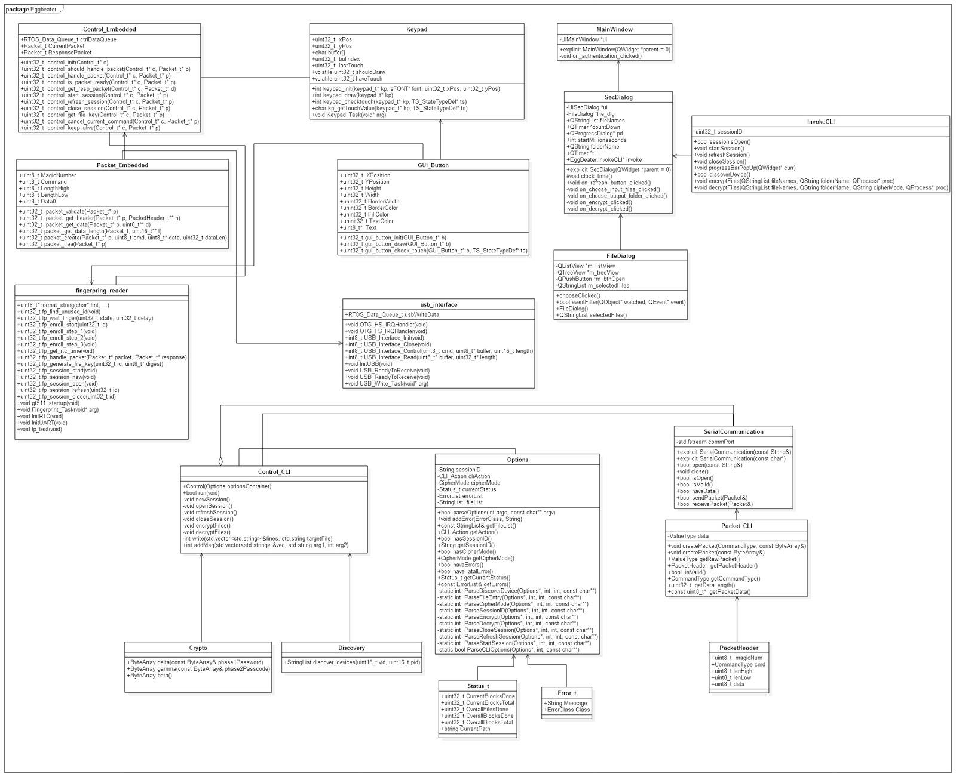
Design: Overall

Slide 7
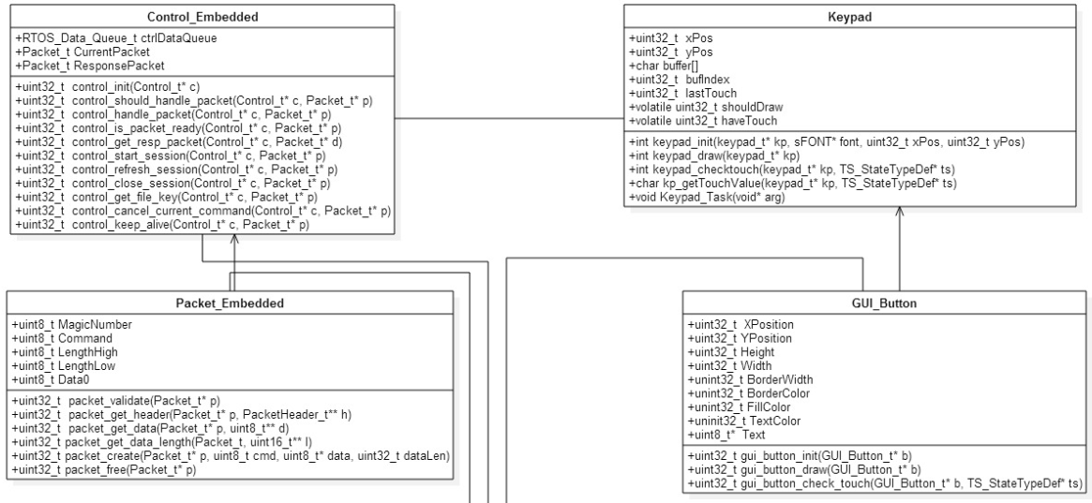
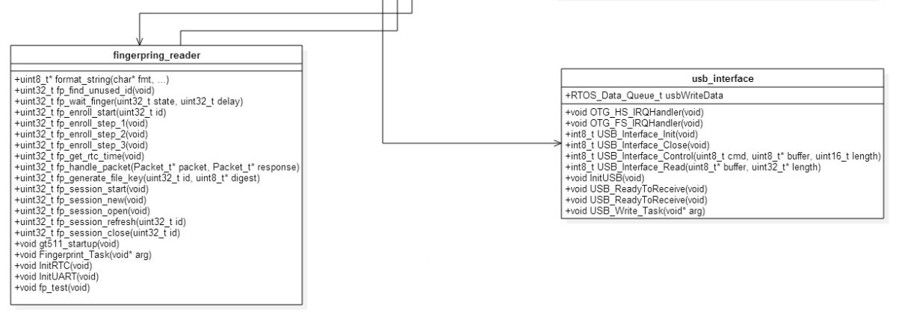
Design: Embedded

Slide 8
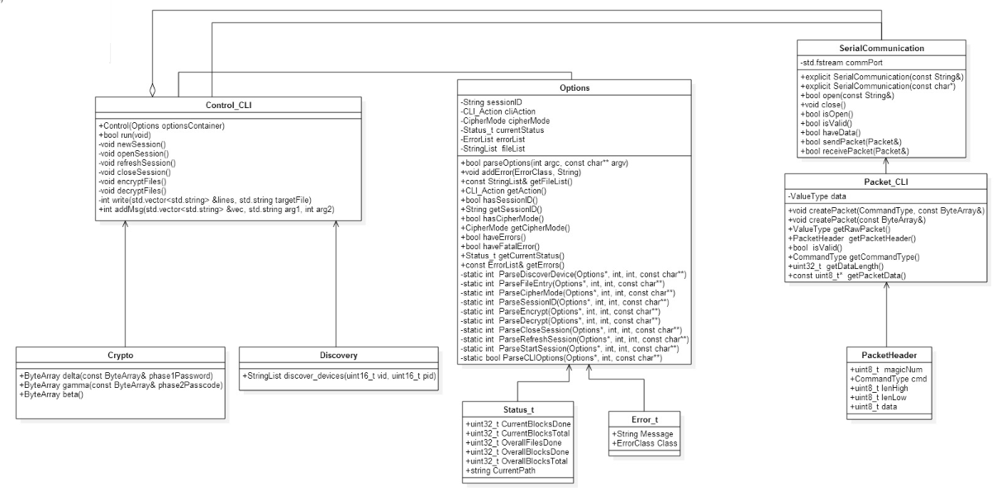
Design: Command line

Slide 9
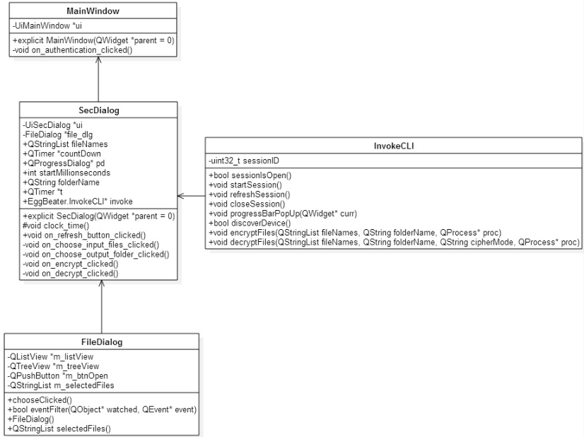
Design: GUI

Slide 10
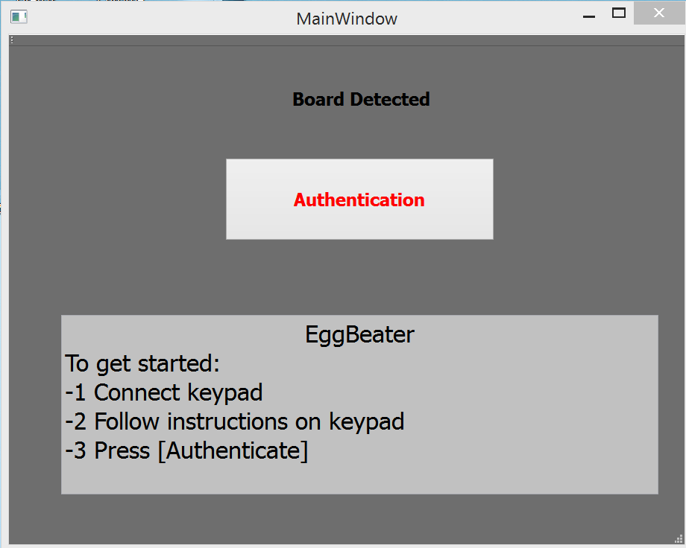
Final GUI Mockup
Notes:
Open GUI and screenshot.

Slide 11
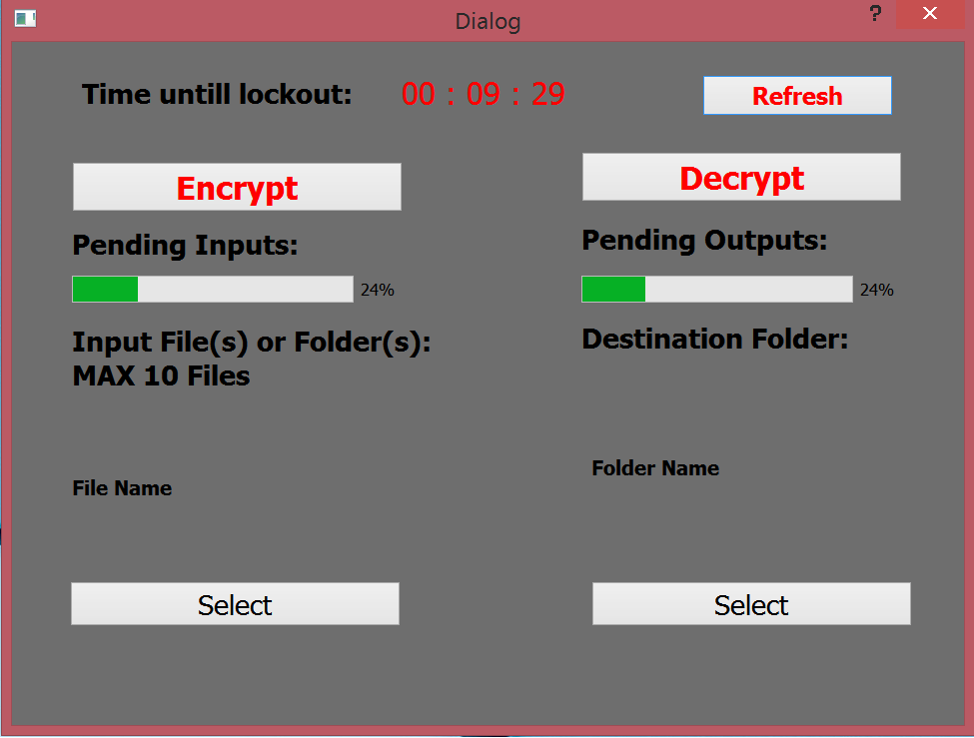
Final GUI Mockup(cont.)

Slide 12
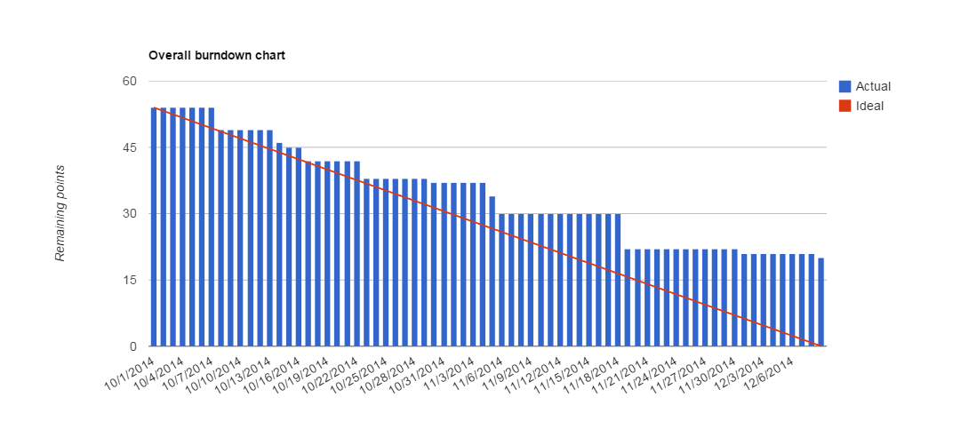
Top-Level Burndown

Slide 13
Testing
Unit testing
Crypto
Command Line
Acceptance testing
Hardware interactions
Device discovery

Slide 14
Test Coverage
Test Coverage
Example -> Encryption Modes
# Unit Tests & # Acceptance Tests
The Untested
Qt

Slide 15
Metrics
Cyclomatic Complexity
Embedded Avg = 3.84
CLI Avg = ##
GUI Avg = ##
Cohesion
##

Slide 16
Maintainability
Split design between three domains
Embedded
Core tool (command line)
GUI wrapper of core tool

Slide 17
Extensibility
Software
Encryption Schemes
GUI options
Mac Compatibility
Linux Compatibility
Qt works!
Hardware
Microcontroller
Keypad

Slide 18
Presented By
Robert Beat
Sterling Miller
Sam Adams
Yuki Ishikawa
Sam Whitsett
Andrew Barton

